Slide 1
Self-Supervised Approach to Facial Recognition
IDC 409
Grace VL (MS21085)
Sidharth SS (MS21080)
Saju S Mukundan (MS21065)

Slide 2
Objective and Overview
Objective: Build a model for face recognition using Self-Supervised Learning (SSL).
What is SSL?
Definition: SSL is a method for learning feature representations from unlabeled data.
Relevance to Face Recognition: SSL allows the model to capture distinctive face features without needing labeled images, making it well-suited for scenarios with limited labeled data.

Slide 3
Advantages of SSL for Face Recognition
Data Efficiency: Leverages abundant unlabeled data, which is easier to collect and store.
Feature Transferability: The SSL-trained encoder generalizes well to new faces and performs effectively with minimal labeled data for fine-tuning.
Reduced Dependency on Labels: Allows effective learning of face features without extensive labeling, reducing time and cost in data preparation.

Slide 4
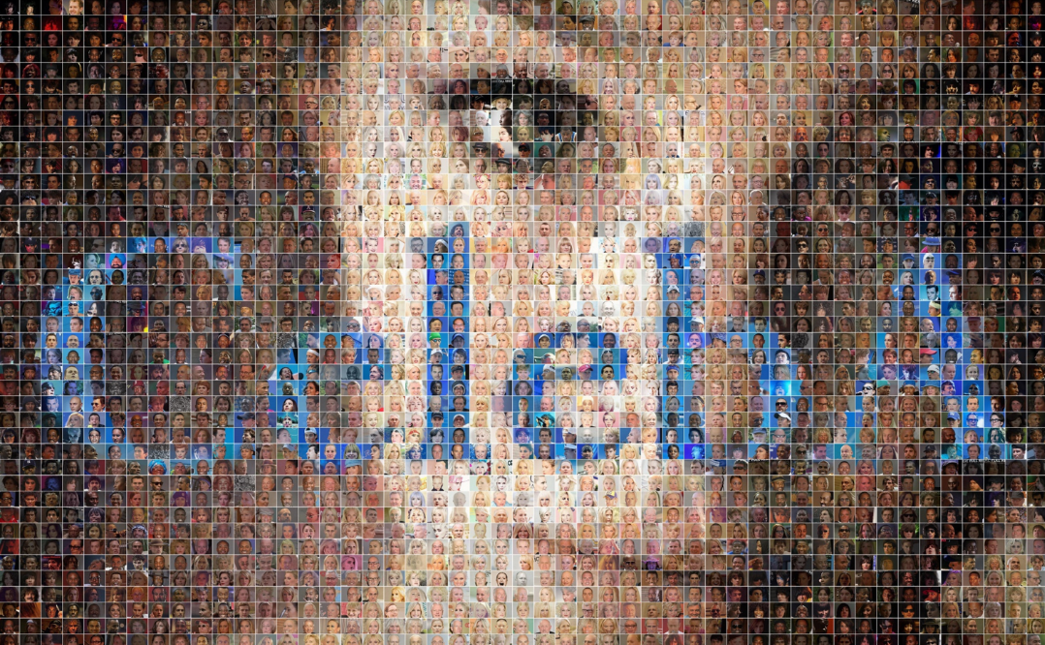
Dataset Preparation
Unlabelled Face Dataset: Custom dataset for unlabeled images used in SSL pre-training. (CelebA dataset)
Labeled Face Dataset: Dataset for labeled face images, used for classifier fine-tuning. (17 classes)
Transformations: Resize, Normalize, Convert to Tensor to prepare images for training.

Slide 5
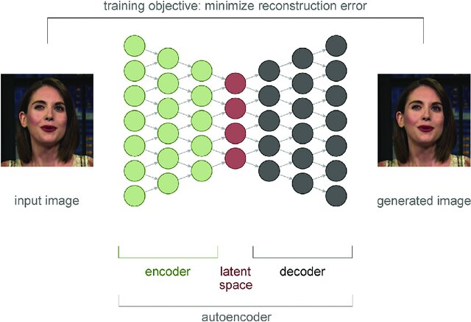
Model Architecture
Encoder: Convolutional layers capture face features.
Decoder: Deconvolutional layers reconstruct images from encoded features.
Objective: Train on unlabeled data to learn face representations that can be used for recognition.

Slide 6
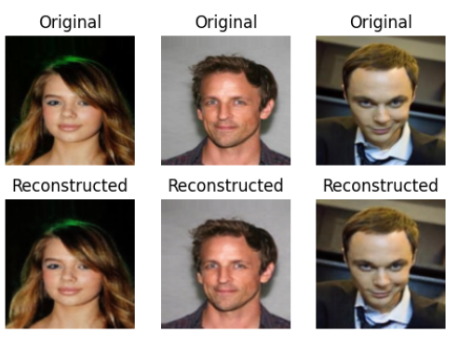
SSL with Autoencoder
Training Objective: Minimize reconstruction loss (MSE) to improve feature quality.
Training Process:
Feed unlabeled images into the model.
Encoder learns face features by reconstructing images.
Results:
Cosine Similarity: 0.9989

Slide 7
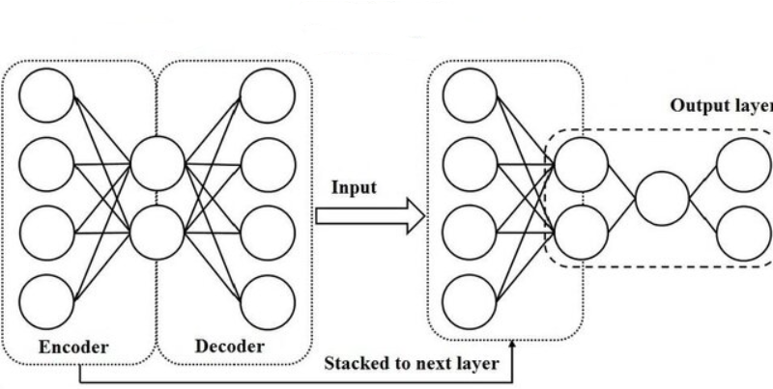
Fine-Tuning for Face Recognition
Classifier Model:
Use encoder from autoencoder as feature extractor.
Add fully connected layer for classification of labeled faces.
Training on Labeled Data: Optimize model with Cross-Entropy Loss, tracking accuracy over epochs.

Slide 8
Saving, Loading, and Utilizing the Model
Model Saving: The trained model is saved as a .pkl file, allowing for easy reusability.
Benefit: Simplifies loading for further testing or deployment, making the model accessible for future use.
Prediction: Once loaded, the model can be used to predict labels for new face images, enabling validation on unseen data.

Slide 9
Future Directions
Larger Datasets: Test the model on a wider range of data to improve generalizability and robustness. Incorporate larger datasets for training during the unsupervised phase to enhance feature learning.
Hyperparameter Tuning: Optimize hyperparameters such as learning rates, batch sizes, and architecture choices to improve model performance.
Alternative SSL Approaches: Experiment with methods like contrastive learning and other self-supervised techniques to enhance feature extraction and representation.
Real-Time Applications: Extend the model for real-time face recognition, integrating it into interactive or live systems for immediate feedback.

Slide 10
References
Datasets:
CelebA Dataset: A large-scale dataset with over 200,000 celebrity images, each labeled with 40 attribute annotations. More information can be found at CelebA Dataset.
Self-Supervised Learning:
Key Papers:
Chen, T., Kornblith, S., Noroozi, M., & Hinton, G. (2020). "A Simple Framework for Contrastive Learning of Visual Representations." In Proceedings of the International Conference on Machine Learning (ICML). Link
Grill, J.-B., Strub, F., Martinez, M., & Michalski, M. (2020). "Bootstrap Your Own Latent: A New Approach to Self-Supervised Learning." In Advances in Neural Information Processing Systems (NeurIPS). Link
Caron, M., Bojanowski, P., Mikolov, T., & Joulin, A. (2018). "Deep Clustering and Optimal Transport." In Proceedings of the International Conference on Machine Learning (ICML). Link
PyTorch Documentation:
Comprehensive resources on model saving/loading and deployment can be found at PyTorch Documentation.

Slide 11
Thank You!

